Slide 1
Run-Time Type Information
CP3 Presentation

Slide 2
What does RTTI mean ?
Run-Time Type Identification
Run-Time Type Information

Slide 3
Purpose of RTTI
To provide information about the type of an object during the run-time.
As a consequence – to support polymorphism.

Slide 4
How RTTI works ?
C++ RTTI can be used to do safe typecasts, using the dynamic_cast<> operator, and to manipulate type information at run time, using the typeid() operator and std::type_info class.
RTTI is available only for classes which are polymorphic, which means they have at least one virtual method. In practice, this is not a limitation because base classes must have a virtual destructor to allow objects of derived classes to perform proper cleanup if they are deleted from a base pointer.
RTTI is optional with some compilers; the programmer can choose at compile time whether to include the functionality. There may be a resource cost to making RTTI available even if a program does not use it.

Slide 5
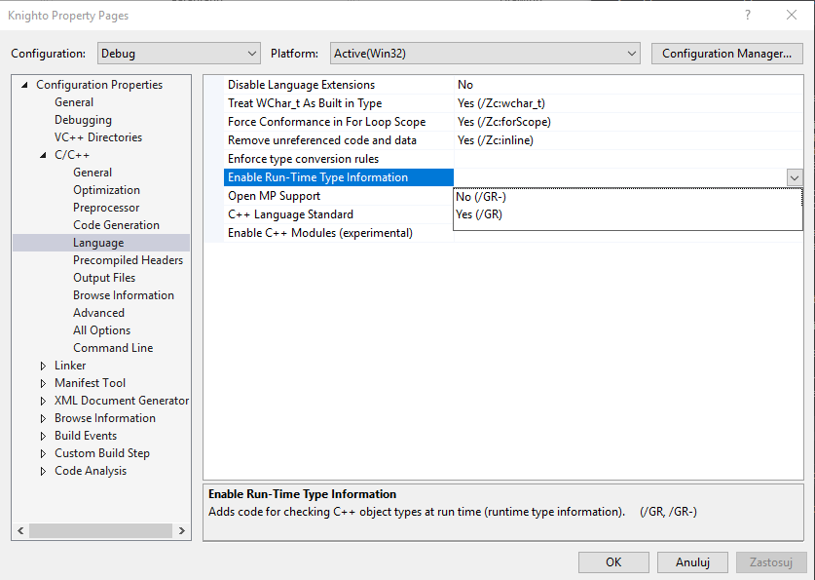
Enabling RTTI in Visual Studio 2017

Slide 6
dynamic_cast operator
Most often used element of RTTI. Operator dynamic_cast creates pointer of derived class from the pointer of base class.
For pointers it returns NULL if TYPE is neither type of object nor its parent
For references it throws exception std::bad_cast if TYPE is neither type of expression nor its parent

Slide 7
Example

Slide 8
typeid operator
The typeid() operator returns the reference to the object of type type_info, which is a class defined in header file <typeinfo>.
Syntax:
typeid(type name)
typeid(expression)
Type_info class:

Slide 9
Obtaining a class (type) name
Syntax:
typeid(expression).name()
Purpose:
Used to print the human-readable name of the type.

Slide 10
Example of typeid() use

Slide 11
Example 2
Shape
Line
Circle
Rectangle
Shape *sp = new Circle;
typeid(shape) == typeid(*sp) //returns false
typeid(shape).before(typeid(*sp)) //returns true
typeid(sp).name() //returns „circle*”
typeid(*sp).name() //returns „circle”

Slide 12

RTTI – laboratory assignment

Slide 13
Sources of information:
https://en.wikibooks.org
C++ Primer Plus, Sixth Edition – Stephen Prata

